Slide 1
National Cancer Institute
Enterprise Vocabulary Services
&
Semantic Interoperability
May 25, 2010
Margaret Haber, Enterprise Vocabulary Services
Larry Wright, Enterprise Vocabulary Services

Slide 2

Interoperability
Interoperability:
  The ability of a system...to use the parts or equipment of another system
  Source: Merriam-Webster web site
Interoperability:
  The ability of two or more systems or components to exchange information and to use the information that has been exchanged.
  Source: IEEE Standard Computer Dictionary, 1990
Syntactic
interoperability
Semantic
interoperability

Slide 3
NCI Design for Interoperability
  Common API Integration: Part of the syntactic component of interoperability.
  Vocabularies/Terminologies/Ontologies: Provides semantic interoperability, used to record information in and about systems and data.
  Data Elements: or Metadata, provides a description of the meaning of recorded information in addition to its value. For example “Patient Temperature” would describe both a meaning and what constitutes a valid value for patient temperature (such as a number range measured in degrees Fahrenheit).
  Information Models: Describe the structure of the data maintained in a system, such as a grid system.

Slide 4
Extending Interoperability Beyond the Enterprise
cancer Biomedical Informatics Grid (caBIG)
  Shared infrastructure, applications and data
  Permits cancer research community to focus on innovation
  Shared vocabulary, data elements, data models enable information exchange
  Interoperable applications developed to common standard
  Making research data available for mining and integration
Several new ARRA initiatives leverage this infrastructure to extend interoperability principles to the broader healthcare community

Slide 5
Semantic Infrastructure Futures
Evolution, not Revolution
    Still gathering requirements and defining approaches
    Aim: support interoperability with a broader range of partners
  Services-Oriented Architecture (SOA) approach.
  Technology-independent specifications that enable others to build interoperable components.
  Design, develop and deploy software components defined as business capabilities rather than monolithic applications.

Slide 6
No Controlled Terminology?
No Interoperability
Systems cannot exchange or use information if they use incompatible codes or tokens to signify meaning
Terminology services provide those tokens and codes
Proper use of them assures consistent meaning across and among enterprises

Slide 7
NCI Enterprise Vocabulary Services (NCI EVS) Goals
  Mission: The development of services and resources that address the needs of the National Cancer Institute (NCI) for controlled terminology, and to facilitate the standardization of terminology and information systems across the Institute and the larger biomedical community.
Goal – Integration by Meaning
Clinical, translational, and basic research terminology have overlapping but specialized needs, therefore EVS assists to:
  Integrate different conceptual frameworks
  Create terminological and taxonomic conventions across diverse systems

Slide 8
Background
EVS began in 1996 as an applied research project; Production started in 1999 with the publication of the NCI Metathesaurus (NCIm). NCI Thesaurus (NCIt) followed in 2000, becoming the primary terminology for NCI coding including for metadata and data model semantics.
NCI EVS also provides freely available tools for terminology/ontology development and publication. NCIt and NCIm are now joined by several other terminologies published or hosted by NCI.
NCI EVS provides the semantic foundation for sharing and re-use of data, services, applications, and other resources at NCI . The caBIG community, other NIH institutes, and many collaborating organizations such as FDA and CDISC also depend on the EVS for terminology needs.

Slide 9
High Value Use Cases
EVS Used Directly for Drug and Clinical Information Integration
  Agents, Clinical Trials and Adverse Events
    CTEP and DCP clinical trials
    PDQ Cancer Clinical Trials Registry & NCI Drug Dictionary
    Federal Medication Terminologies (FMT)
    FDA Structured Product Labeling
    NCPDP (SCRIPT Standard for e-prescribing)
caBIG infrastructure and application use cases
  Infrastructure providing semantic interoperability
  caTIES/caTissueCore/caMOD/caNanolab
FDA/NCI/CDISC/RCRIM – harmonization/ development - standards

Slide 10
EVS Resources
NCI Thesaurus (NCIt) – an ontology-like terminology
NCI Metathesaurus (NCIm) – mapped vocabularies
  NCI Term Browser - NCI and external vocabularies maintained and served: MedDRA, HL7, NDF-RT, LOINC, GO, Zebrafish, etc.
Terminology development, licensing & publication; software and server development & licensing; FTP sites & API development

Slide 11
NCI Thesaurus (NCIt)
Standard reference terminology/ontology for clinical, biomedical and scientific knowledge used by NCI, caBIG; underpins caCORE/caBIG/caGRID semantics
A Federal Standard Terminology
Built using description logics
Public domain, open content license
Used by many public and private partners, nationally and internationally

Slide 12
NCI Thesaurus (2)
Broad coverage of cancer and other clinical and research domains including prevention and treatment trials:
  Neoplastic and other Diseases
  Findings and Abnormalities
  Anatomy, Tissues, Subcellular Structures
  Agents, Drugs, Chemicals
  Genes, Gene Products, Biological Processes
  Animal Models – Mouse, other
  Research techniques and management, apparatus, clinical and lab, radiology, imagery

Slide 13
NCI Thesaurus (3)
Published Monthly
89,000 “Concepts” hierarchically organized into domains
Concept History
Available on-line and by download (OWL, LexGrid XML, flat files)
Accessible through the LexEVS API and caGrid terminology node

Slide 14
What ‘s in NCIt ?
Events & Entities
⇒
+89,000 concepts
Hierarchical arrangement
Preferred Names,
Synonyms & Definitions
Concept relationships & properties
Unique,
permanent identifier codes

Slide 15
Semantic Diversity
plants
fungus
virus
bacterium
eukaryote
archaeon
animal
vertebrates
amphibian
bird
fish
reptile
mammal
human
embryonic structure
laboratory tests
medical device
anatomical structure
anatomical abnormality
bodyparts &organs
congenital abnormality
language
clinical drug
tissue
sign or symptoms
nucleic acid
regulation or law
findings
gene
geographic area
research activity
cell s
molecular sequence
genetic function
family group
neoplastic process
disease or syndrome
educational activity
Mental process
natural phenomenon
event
experimental model of disease
therapeutic or preventative procedure
behavior
health care activity
activity
organization
laboratory procedure
quantitative concept
element,ion,isotope

Slide 16
Terminology Subsets

Slide 17
FDA-NCI
Memorandum of Understanding
Significance of MOU
  Avoids expenditure at FDA to replicate existing, available resources at NCI
  Increased return on investment for NIH/NCI
Leverages multiple efforts
  FDA collaboration with NIH/NCI results in improved trials, drug and related regulatory terminology for cancer and the broader clinical trials community
  Complementary to the CDISC/NCI collaborations on terminology requirements for CDISC models such as the Study Data Tabulation Model (SDTM)

Slide 18
Scope of MOU (2)
Under the MOU:
  NCI leverages terminology-related resources to address FDA needs
  FDA and NCI coordinate regarding relevant terminology standards and standards development efforts such as those of the HL7 RCRIM technical committee
  FDA and NCI seek to identify opportunities to employ consistent terminology and terminology practices, for example in support of FHA/ONC initiatives and goals and such as eGOV

Slide 19
NCI-FDA Terminology
Collaboration
2002- partnership and agreements in several terminology areas.
  Structured Product Labeling (SPL)
  Unique Ingredient Identifier (UNII)
  Regulated Product Submission (RPS)
  Individual Case Safety Report (ICSR)
  Center for Devices and Radiological Health (CDRH)
FDA PDUFA IV IT Plan:
“For terminology standards, the FDA partners with the National Cancer Institute Enterprise Vocabulary Services (EVS). The NCI EVS hosts the FDA terminologies and makes them freely available to the public.”
FDA terminology resources are available on the NCI portal website:
http://www.cancer.gov/cancertopics/terminologyresources/FDA

Slide 20
Example:
Structured Product Label
FOR IMMEDIATE RELEASE P05-80 November 2, 2005 | Media Inquiries: Kristen Neese, 301-827-6242 Consumer Inquiries: 888-INFO-FDA
FDA Announces the Use of New Electronic Drug Labels to Help Better Inform the Public and Improve Patient Safety
In a continuing effort to use modern information technology to help inform the public and health care providers and to further improve patient safety, the Food and Drug Administration (FDA) today began requiring drug manufacturers to submit prescription drug label information to FDA in a new electronic format. This electronic format will allow healthcare providers and the general public to more easily access the product information found in the FDA-approved package inserts ("labels") for all approved medicines in the United States.
Pharmaceutical Companies must provide information for electronic labels to FDA using controlled terminology

Slide 21
FDA Structured Product Labels
FDA needs rapid turnaround terminology for the content of labels but doesn’t want to be in the terminology business.
FDA requests terminology in various areas related to product labels, NCI editors work with them, integrate them into NCI Thesaurus, and tag them with subset properties. FDA publishes the lists on their website, and provides links to NCI Thesaurus.
  Examples
    Route of Administration
    Unit of Presentation (Potency)
    Dosage Form
    Package Type
FDA SPL Web page:
http://www.fda.gov/oc/datacouncil/spl.html

Slide 22
SPL in NCIt
  For solid oral dosage form appearance
    SPL Color – BLUE C48333
    SPL Shape - ROUND C48348
  For drug interactions
    Contributing Factor - General - FOOD OR FOOD PRODUCT C1949
    Type of Drug Interaction Consequence - PHARMACOKINETIC EFFECT C54386
    Pharmacokinetic Effect Consequence - INCREASED DRUG LEVEL C54355
    Limitation of Use – CONTRAINDICATION C50646
    Sex – FEMALE C16576
    Race - ASIAN C41259
  Other
    SPL DEA Schedule - CII C48675

Slide 23
Concept details from Browser

Slide 24
Concept details from Browser (2)

Slide 25
CDISC Terminology
Clinical Data Interchange Standards Consortium (CDISC) is an international, non-profit organization that develops and supports global data standards for medical research.
FDA points to CDISC as key provider of clinical & preclinical standards: “The foundation for the standardized clinical content is the Clinical Data Interchange Standards Consortium (CDISC) Study Data Tabulation Model (SDTM).”
FDA PDUFA IV IT Plan
EVS is partnered with CDISC to support and publish SDTM and other CDISC terminology including SEND (animal studies), Glossary, CDASH
CDISC terminology also published on NCI portal website:
http://www.cancer.gov/cancertopics/terminologyresources/CDISC

Slide 26
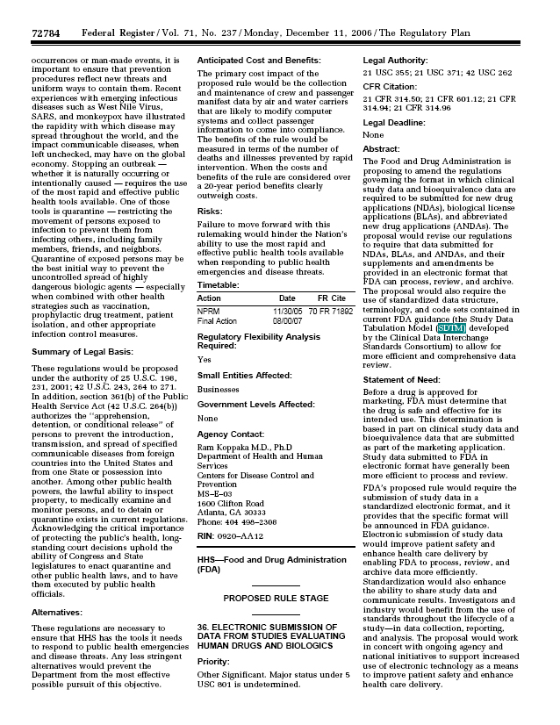
Federal Register / Volume 71, No. 237 /
Monday, December 11, 2006
The Food and Drug Administration is
proposing to amend the regulations
governing the format in which clinical
study data and bioequivalence data are
required to be submitted for new drug
applications (NDAs), biological license
applications (BLAs), and abbreviated
new drug applications (ANDAs). The
proposal would revise our regulations
to require that data submitted for
NDAs, BLAs, and ANDAs, and their
supplements and amendments be
provided in an electronic format that
FDA can process, review, and archive.
The proposal would also require the
use of standardized data structure,
terminology, and code sets contained in
current FDA guidance (the Study Data
Tabulation Model (SDTM) developed
by the Clinical Data Interchange
Standards Consortium) to allow for
more efficient and comprehensive data
review.

Slide 27
NCIthesaurus http://ncit.nci.nih.gov
Search Box
Choices, choices...
Version information
Notes:
Let's take a look at the NCIt public browser available at the website listed above. [click] You have the option of browsing the Thesaurus by looking at the entire hierarchy or subsets. Or if you are interested in a specific term or collection of terms first you can use the search text box. Within the search field, you type in what you are looking for and choose your search parameters. We also provide the version information, which is the date of publication, of the information contained within this version of the browser. I'd also like to point out the links to the NCI Metathesaurus and term browser that my colleague will be discussing in a few slides.

Slide 28
Term search
Search on term - mg - 5 results

Slide 29
Code Search
Search on Code - 1 result
6
sources

Slide 30
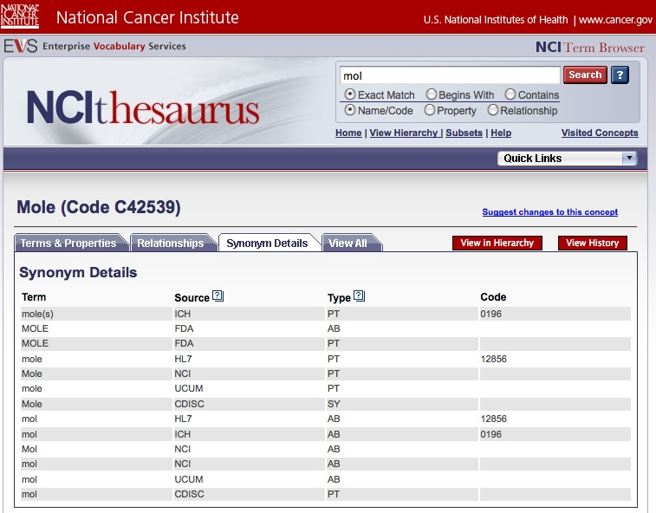
Concept Code:
A unique, permanent identifier
mammal?
spy?
chemistry measure-ment?
chocolate sauce?
skin lesion?
Concept Code
Terms
Term
Source
Additional Source Data
Notes:
The concept code located next to the NCI preferred term is important because it ensures that all sources are referring to the same meaning for their term. For example, this mole concept is referring to the chemistry mole, as opposed to the mammal, the spy, the food, or the skin condition.

Slide 31
Concept Code:
A unique, permanent identifier (2)
Concept Code
Terms
Additional Source Data
Term
Source
Notes:
The concept code located next to the NCI preferred term is important because it ensures that all sources are referring to the same meaning for their term. For example, this mole concept is referring to the chemistry mole, as opposed to the mammal, the spy, the food, or the skin condition.

Slide 32
Unambiguous Meaning
Semantic Type: Quantitative Concept
Code: C42539
Definition: A unit of amount of substance, one of the seven base units of the International System of Units (Systeme International d'Unites, SI). It is the amount of substance that contains as many elementary units as there are atoms in 0.012 kg of carbon-12. When the mole is used, the elementary entities must be specified and may be atoms, molecules, ions, electrons, other particles, or specified groups of such particles.
Semantic Type: Mammal
Code: C14876
Definition: A small, furry creature of the family Talpidae that lives underground and feeds on small invertebrates. The mole has tiny covered eyes that are believed to be able to distinguish night from day, and not much else.
Semantic Type: Neoplastic Process
Code: C7570
Definition: A neoplasm composed of melanocytes that usually appears as a dark spot on the skin.
mole
Semantic Type: Occupation or Discipline
Definition: [No use case for this term yet, but welcome CIA inquiries].
Semantic Type: Food or Food Product
Definition: [No use case for this term yet, but welcome inquiries accompanied by samples].

Slide 33
Concept Relationships
& Associations
Subset Associations:
How concepts are "bundled"
Notes:
On the relationships tab within the 'sitting' concept you will see the relationship data connected to this concept. Delete box around role relationships...] Our primary method of bundling concepts for easy retrieval is via an association called a subset. As you can see this CDISC concept belongs to five different subsets including......

Slide 34
NCIt: Example Concept (1 of 2)
Preferred Name: Gastric Mucosa-Associated Lymphoid Tissue Lymphoma
Code: C5266
Semantic Type: Neoplastic Process
Parent Concepts: Extranodal Marginal Zone B-Cell Lymphoma of Mucosa-Associated Lymphoid Tissue
Gastric Non-Hodgkin's Lymphoma
Synonyms & Gastric MALT Lymphoma
Abbreviations: Gastric MALToma
(subset) MALT Lymphoma of the Stomach
MALToma of the Stomach
Primary Gastric MALT Lymphoma
Primary Gastric B-Cell MALT Lymphoma
Primary MALT Lymphoma of the Stomach
Definition: A low grade, indolent B-cell lymphoma, usually associated with Helicobacter Pylori infection. Morphologically it is characterized by a dense mucosal atypical lymphocytic (centrocyte-like cell) infiltrate with often prominent lymphoepithelial lesions and plasmacytic differentiation. Approximately 40% of gastric MALT lymphomas carry the t(11;18)(q21;q21). Such cases are resistant to Helicobacter Pylori therapy.

Slide 35
NCIt: Role Relationships (Gastric MALT Lymphoma)
Role Relationships (subset) for Gastric Mucosa-Associated Lymphoid Tissue Lymphoma:
Molecular abnormalities:
Disease_May_Have_Cytogenetic_Abnormality: Trisomy 3
Disease_May_Have_Cytogenetic_Abnormality: Trisomy 18
Role group 1:
Disease_May_Have_Cytogenetic_Abnormality: t(11;18)(q21;q21)
Disease_May_Have_Molecular_Abnormality: AP12-MLT Fusion Protein Expression
Histogenesis:
Disease_Has_Normal_Cell_Origin: Post-Germinal Center Marginal Zone B-Lymphocyte
Pathology:
Disease_Has_Abnormal_Cell: Centrocyte-Like Cell
Disease_May_Have_Abnormal_Cell: Neoplastic Monocytoid B-Lymphocyte
Disease_May_Have_Abnormal_Cell: Neoplastic Plasma Cell
Disease_May_Have_Finding: Lymphoepithelial Lesion
Anatomy:
Disease_Has_Primary_Anatomic_Site: Stomach
Disease_Has_Normal_Tissue_Origin: Gut Associated Lymphoid Tissue
Clinical information:
Disease_Has_Finding: Primary Lesion
Disease_May_Have_Finding: Indolent Clinical Course
Disease_May_Have_Associated_Disease: Hepatitis C

Slide 36
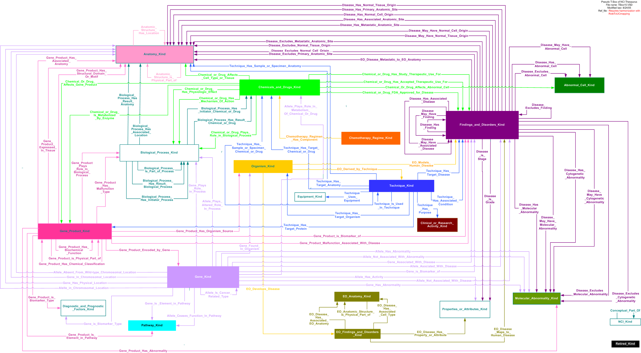
NCIt: 200,000 Role Relationships

Slide 37
NCI Metathesaurus
Purpose: Integrating biomedical and scientific data from some 76 national and international sources into one database.
Approximately 3.6 million terms integrated into 1.4 million concepts
Provides a mapped overlap and partial inter-relation of current versions of NCI and partner required vocabularies, for ex. the ICD’s, MedDRA, SNOMED, MeSH (NLM Medical Subject Headings), HCPCS (procedures), LOINC (lab values), drug terminologies (VA NDF-RT, AOD, RxNORM, Multum, NCI Thesaurus drugs, etc.)
Used as online dictionary and thesaurus, for mapping and document indexing.
Minor releases monthly, major releases at least twice a year.

Slide 38
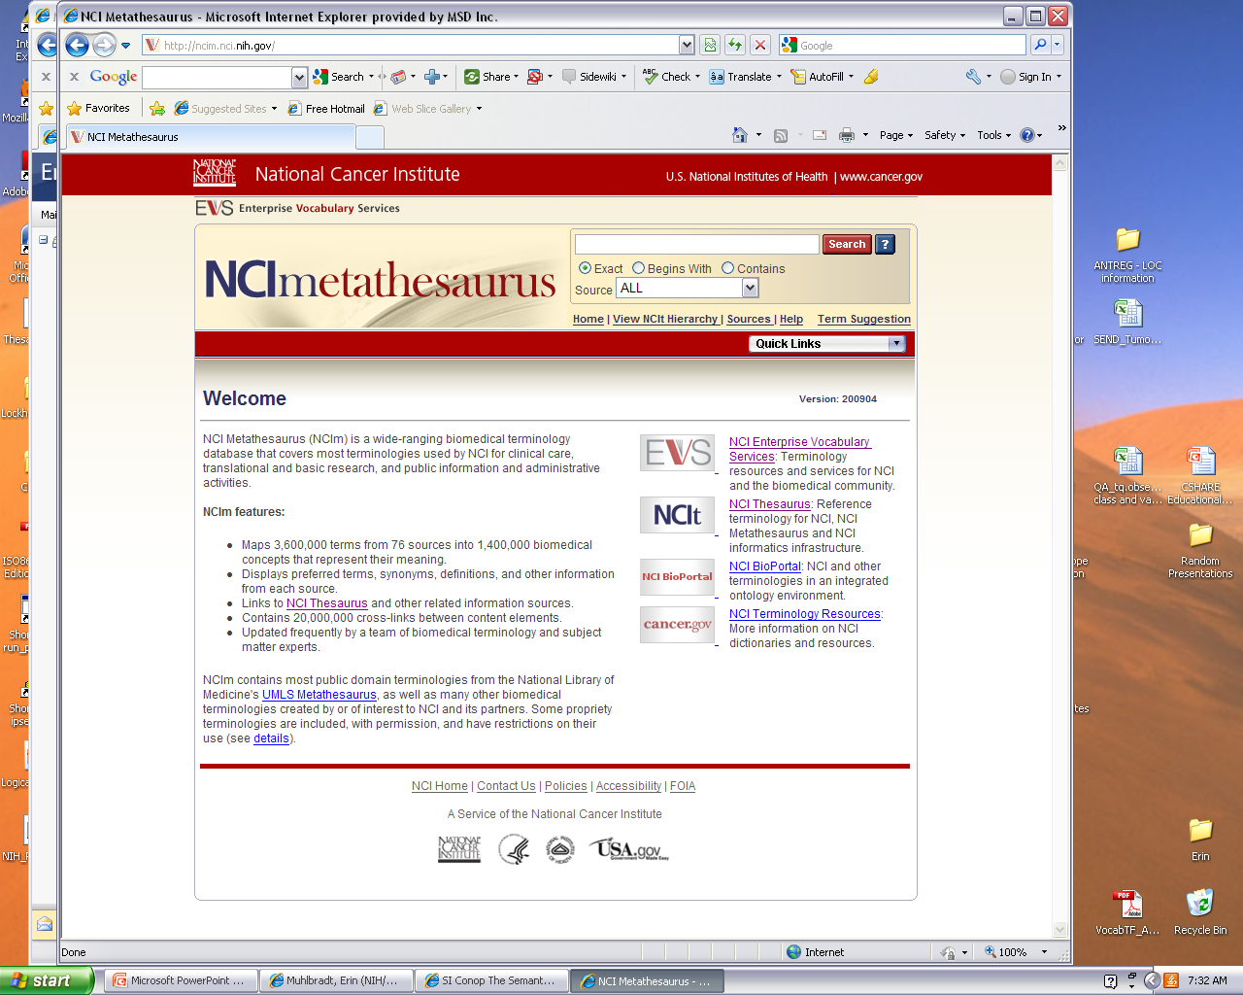
NCI Metathesaurus https://ncim.nci.nih.gov
3,600,000 terms
76 Sources
1,400,000 concepts
Notes:
Another resources within NCI-EVS is the NCI Metathesaurus. The purpose of the Metathesaurus is to group together and link data from multiple outside terminologies. Currently the Metathesaurus contains terminology from over 76 national and international sources that provide terminology over a wide range of areas such as drugs, clinical activities, organisms, nursing, and biomedical areas. The Metathesaurus contains around 1.4 million concepts comprised of 3.6 million preferred names and synonyms from different sources. As you can see, the Metathesaurus browser is built on the same platform as the Thesaurus browser so there will be similar functionality.

Slide 39
NCImetathesaurus
Choose your source
11 Sources
Notes:
This is an example of data within a Metathesaurus concept. As you can see we have a wide range of sources within this concept, including LOINC, CDISC, SNOMED, and ICDO. An advantage of the Metathesaurus is that you can see each source has its own term bundled up under a single concept with a unique identifier. NCI-EVS staff curates the Metathesaurus and updates every three months.

Slide 40
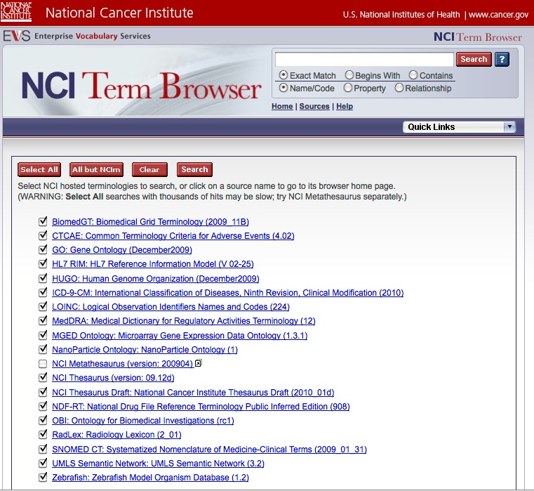
NCITerm Browser http://nciterms.nci.nih.gov
Sources
Notes:
I just showed the Metathesaurus which bundles 76 source terminologies within one data resources. Another service that NCI EVS offers is the new Term Browser, it is built on the same platform so you will notice a lot of the same functionality. What the term browser offers is many different terminologies in a stand alone environment, meaning you can search for content in individual terminologies. Or, if you wanted to search in the GO, the gene ontology, you can limit your search to that particular terminology; if you wanted to search in a specific combination of terminologies, you have this functionality as well. You can check and uncheck the boxes or choose a default selection via the buttons located at the top. The reasoning for this functionality is that the Metathesaurus is so large that otherwise the search may be slowed down.

Slide 41
EVS Products & Services
Are Open
NCI Thesaurus is Open Content
http://evs.nci.nih.gov/terminologies
NCI Metathesaurus is Mostly Open Source
(See Each Source’s License) http://ncim.nci.nih.gov/ncimbrowser/pages/source_help_info.jsf
NCI EVS Servers Are Freely Accessible
  On the Web:
http://nciterms.nci.nih.gov
http://ncimeta.nci.nih.gov
  Via API:
  https://cabig.nci.nih.gov/tools/LexEVS_API
  On caGrid:
  https://cabig.nci.nih.gov/workspaces/Architecture/caGrid
All Software Developed by NCI EVS is Public Open Source and Free for the Asking:
http://ncicb.nci.nih.gov/download/#ETools

Slide 42
Methods of Data Retrieval
    NCI ftp site: http://evs.nci.nih.gov/ftp1/FDA
    NCI partner web sites (CDISC, FDA, etc.)
    Request a report from NCI staff: http://ncit.nci.nih.gov/ncitbrowser/pages/contact_us
    NCIt Browser by subset :
    http://ncit.nci.nih.gov/pages/subset.jsf
    Cancer.gov:
    http://www.cancer.gov/cancertopics/terminologyresources
Notes:
So, we have given an overview of what data is in the thesaurus, how can you get the data? We have multiple methods by which a user can retrieve this content. One can retrieve CDISC terminology from the NCI page, with the reference link provided here, one can also download the CDISC terminology from the file transfer protocol site. Links exist on the CDISC and FDA sites and EVS provides a mechanism by which a user can request any terminology subsets from the NCI thesaurus. Finally, we also provide CDISC FDA and FMT terminologies from our NCI browser, which we will be showing you in upcoming slides.

Slide 43
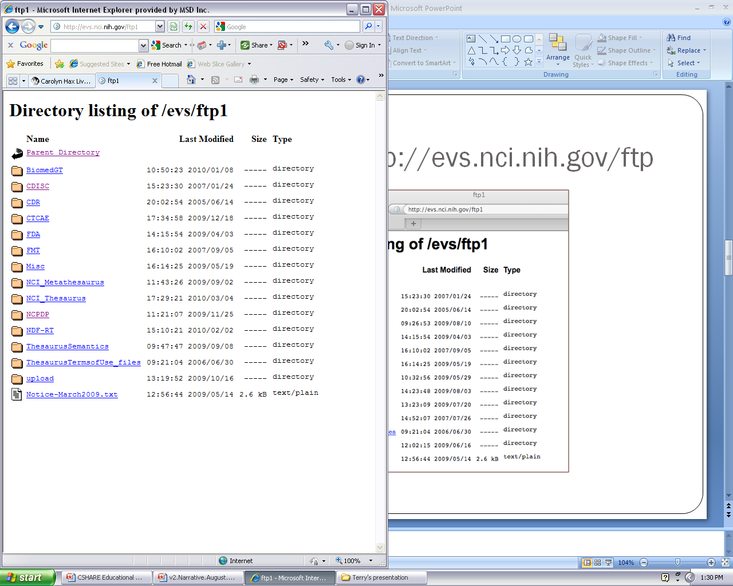
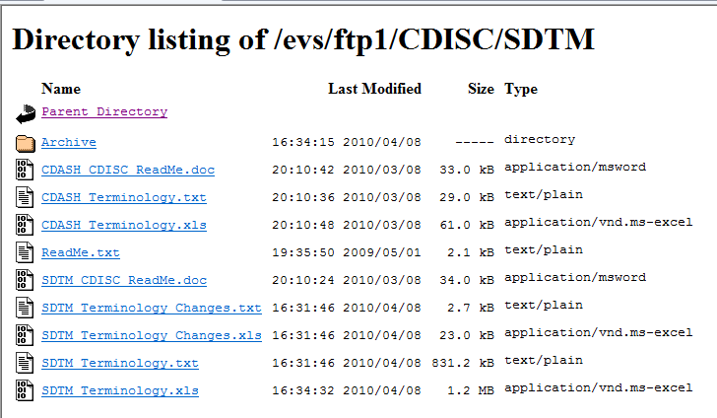
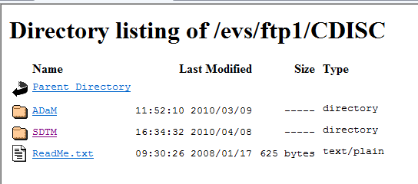
NCIt ftp site http://evs.nci.nih.gov/ftp1
You can download the entire NCIt in various formats

Slide 44



Shared Content Standards
NICHD NHLBI
NINDS
NLM
NIH “Roadmap”
caBIG
UNIIs
ICSR
SPL
RPS
CDRH
Admin Procedures
Other
SDTM CDASH SEND ADaM
Glossary
SHARE
Therapeutic Area Standards

Slide 45










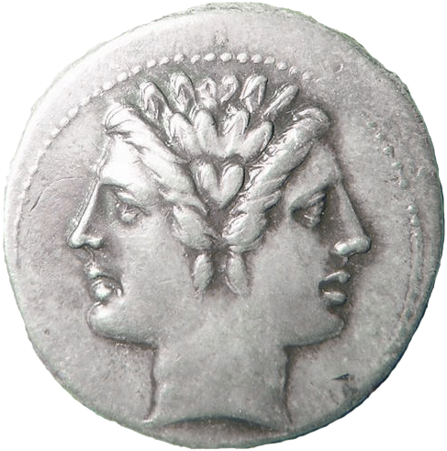
Consolidated Content Services
FedMed
SNOMED CT®
UCUM

Slide 46
Contact Information
Lawrence W Wright
Acting Director
Semantic Infrastructure
NCI
lwright@mail.nih.gov
Margaret Haber
Associate Director
Enterprise Vocabulary Services
NCI
mhaber@mail.nih.gov

